Slide 1
OLIMP BET
Made by:
Ruslan Bakhyshev ITSE-1908R

Slide 2
Project description
My site is a betting site (bookmaker's office). Modern and easy to use.
OLIMPBET.KZ

Slide 3
Project relevance
Sports betting is an extremely painstaking work, which requires a reliable partner in the form of a betting platform that functions stably. Therefore, current bookmakers are of great interest to players. With them, the game becomes stable, and the earnings become constant. Below we will figure out in detail which bookmakers should be considered relevant, and also highlight some of the best bookmakers in Russia and abroad.

Slide 4
Project features
By going to my site you can see the current competitions around the world at the moment. Place a bet on any event (soon). In the footer you can see clickable pictures on our social networks and on the download of our mobile application.You can also contact the offline support service.

Slide 5
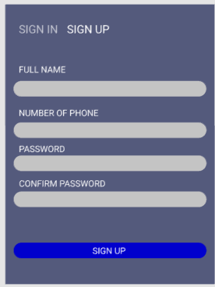
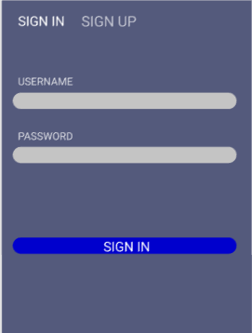
Project Demonstration
Registration and login page:

Slide 6
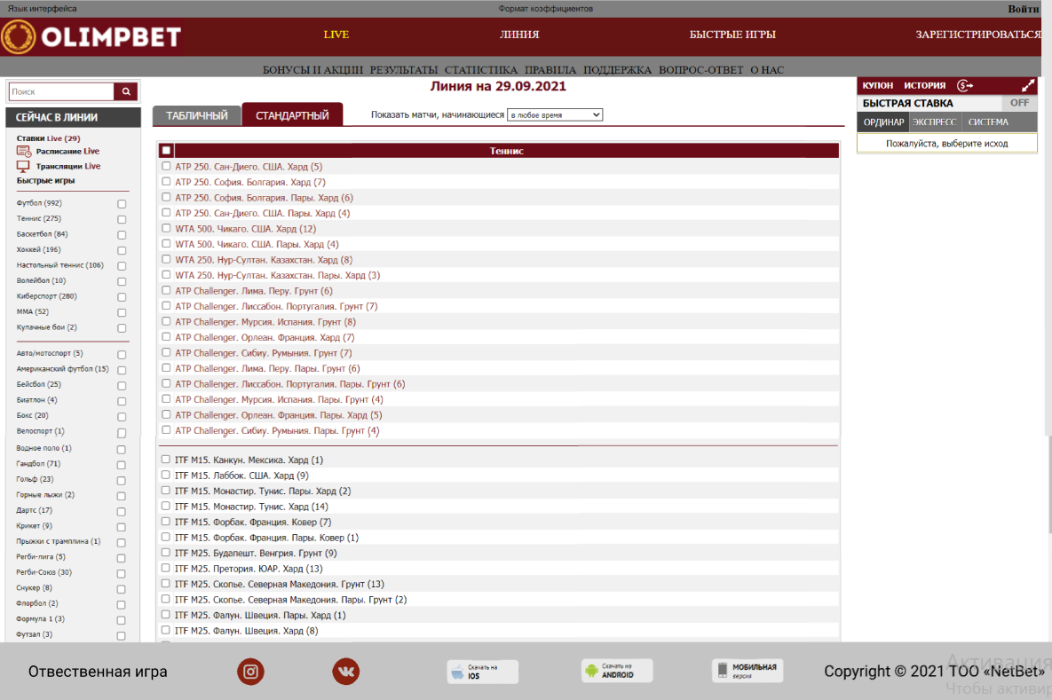
Project demonstration
Bet page:

Slide 7
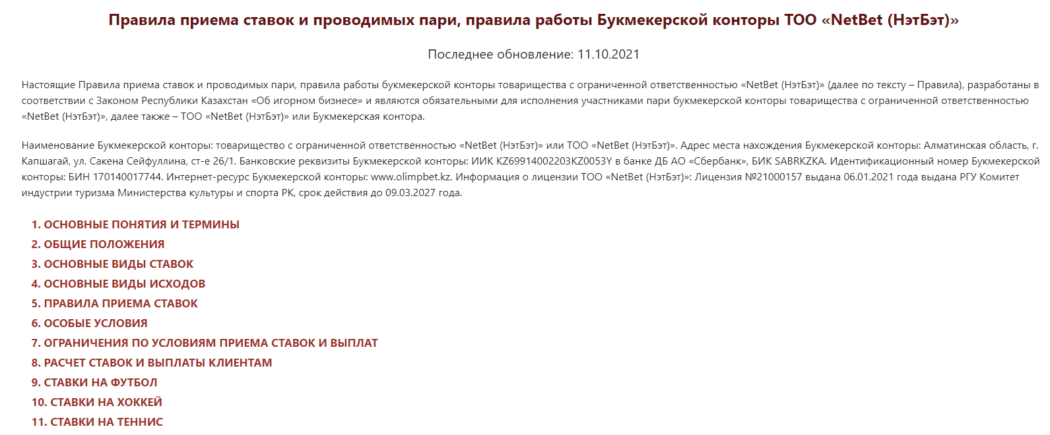
Project demonstration Rules

